Slide 1

Zepto Grocery Data Visualization
Data Analysis & Insights
By Gaurav Layak

Slide 2
Introduction & Objective
Objective: Analyze Zepto's grocery sales to identify trends, optimize inventory, and improve customer experience.
Key Questions Addressed:
- Which product categories drive the most revenue?
- How does customer spending vary across age groups?
- Which cities contribute the most orders?
- How efficient is the delivery process?

Slide 3
Data Overview
1. Dataset Contains : OrderID, CustomerID, OrderTimestamp, City, PaymentMode, ProductCategory, ProductName, Price, DiscountPercentage, FinalPrice, Quantity, TotalSpend, CustomerAgeGroup, DeliveryTimeMinutes, RiderRating.
2. Data Cleaning & Preprocessing :
Standardized product categories for consistent reporting.
Handled missing values in rider ratings and order data.
3. SQL Query Optimization :
Created zepto database.
Performed SQL queries and EDA to find various metrics e.g. (Most Selling Product Categories, Most Preferred Payment Mode, Most Discounted Product, Peak Hours for orders, Repeated Purchases etc.)
4. Power BI Dashboard Development :
Bar Charts: Product category sales breakdown.
Line Charts: Spending trends by customer age groups.
Interactive Filters: Dynamic insights on payment modes and time-based trends.

Slide 4
Key Metrics & Insights
Total Revenue: ₹6.88 Million.
Top-Selling Category: Vegetables (₹ 1.20M), followed by Beverages and Fruits.
Customer Behavior: 18-25 and 51+ age groups are the highest spenders.
City-Wise Performance: Delhi and Bangalore have the most orders.
Delivery Efficiency: Average delivery time is 27 minutes (room for optimization).
High-Value Customers: Identified top spenders for targeted loyalty programs.
Average Rating: Average rating given is 4.25 out of 5.

Slide 5
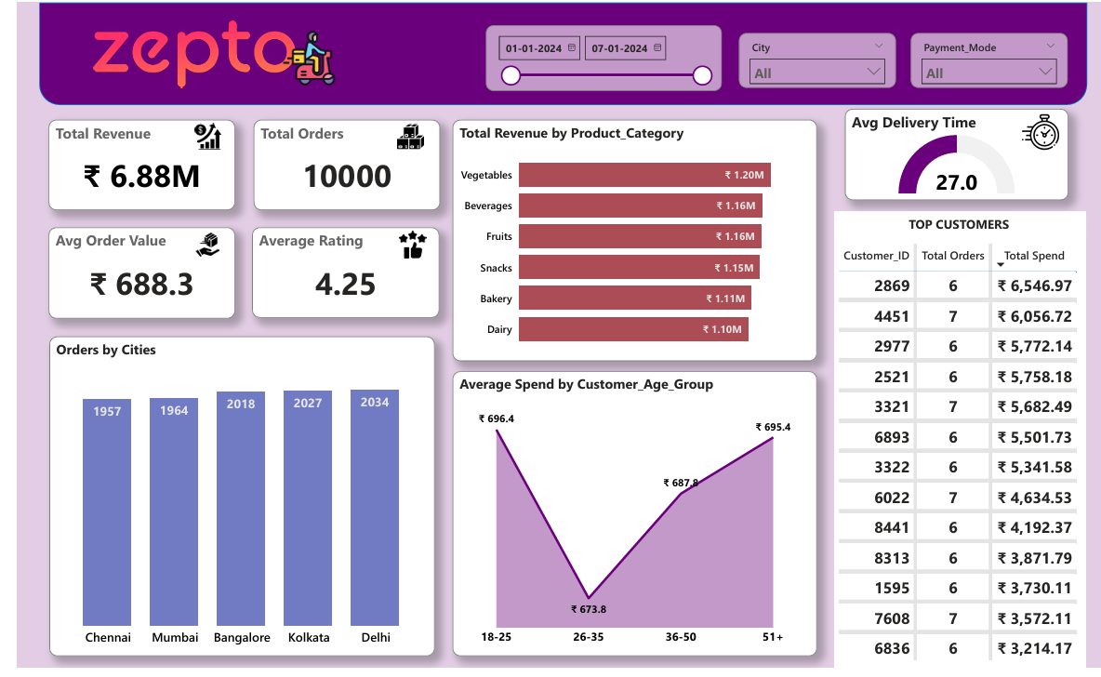
Visualizations & Dashboard Walkthrough

Slide 6
Business Recommendations
✔ Optimized Inventory Management – Focus on high-selling product categories.
✔ Improved Customer Retention – Develop targeted loyalty programs for high-spending groups.
✔ Enhanced Delivery Efficiency – Identify bottlenecks in cities with longer delivery times.

